Slide 1
CMPT 241 - Web Programming
Introduction and Basic HTML

Slide 2
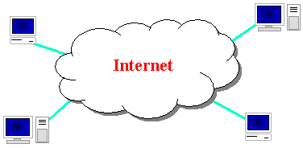
What is the internet?
A collection of computer networks that use the Internet Protocol (IP) to exchange data
layers of communication protocols: IP → TCP/UDP → HTTP/FTP/POP/SMTP/SSH...

Slide 3
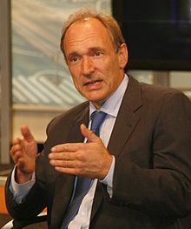
Brief history
WWW created in 1989-91 by Tim Berners-Lee
Popular web browsers released:
Netscape 1994
IE 1995
Amazon.com opens in 1995
Google January 1996
Wikipedia launched in 2001
Facebook February 2004

Slide 4



People and organizations
Internet Engineering Task Force (IETF): internet protocol standards
Internet Corporation for Assigned Names and Numbers (ICANN): decides top-level domain names
World Wide Web Consortium (W3C): web standards

Slide 5
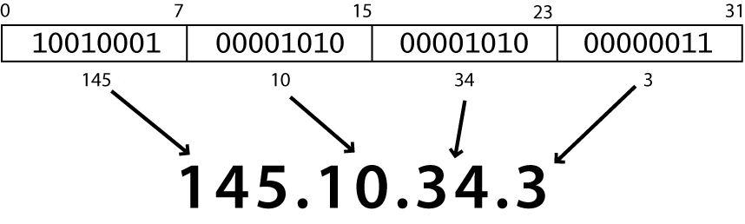
Internet Protocol (IP)
Simple protocol for data exchange between computers
each device has a 32-bit IP address written as four 8-bit numbers (0-255)
find out your local IP address:
in a terminal, type: ipconfig (Windows) or ifconfig (Mac/Linux)

Slide 6
Transmission Control Protocol (TCP)
Adds multiplexing, guaranteed message delivery on top of IP
Multiplexing: multiple programs using the same IP address
Port: a number given to each program or service
port 80: web browser
port 25: email
port 22: ssh
Some programs (games, streaming media programs) use simpler UDP protocol instead of TCP
Notes:
ACK for guarantee data delivery, re-transmit, validity checking
Multiple programs and services share the same internet connection
Freedom from reliability worries
UDP: unreliable but faster

Slide 7
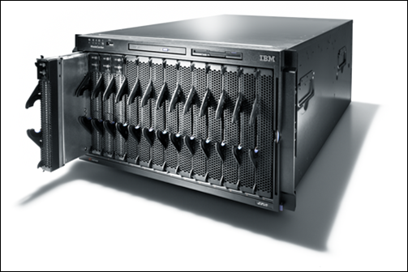
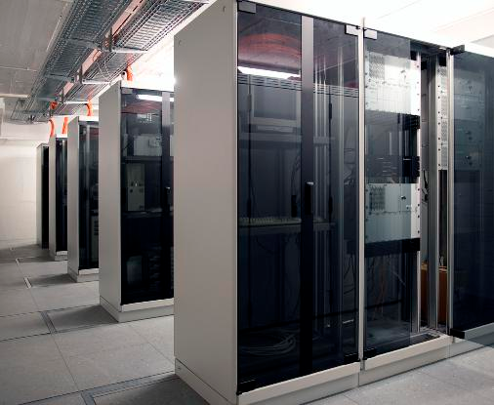
Web Servers
Web server: software that listens for web page requests
Apache (all platforms)
Microsoft Internet
Information Server (IIS)
Notes:
Normal computers, just more powerful
They run specialized SW

Slide 8
Uniform Resource Locator (URL)
an identifier for the location of a document on a web site
a basic URL:
http://www.aw-bc.com/info/regesstepp/index.html
~~~~ ~~~~~~~~~~~~~ ~~~~~~~~~~~~~~~~~~~~~~~ protocol host path

Slide 9
More advanced URLs
anchor: jumps to a given section of a web page
http://www.textpad.com/download/index.html#downloads
fetches index.html then jumps down to part of the page labeled downloads
port: for web servers on ports other than the default 80
http://www.cs.washington.edu:8080/secret/money.txt

Slide 10
More advanced URLs
query string: a set of parameters passed to a web program
http://www.google.com/search?q=miserable+failure&start=10
parameter q is set to "miserable+failure"
parameter start is set to 10

Slide 11
Hypertext Transport Protocol (HTTP)
Set of commands understood by a web server and sent from a browser
Some HTTP commands (your browser sends these internally):
GET: download
POST: send a web form response

Slide 12
HTTP Error Codes
When something goes wrong, the web server returns a special "error code" number
Common error codes:
Number | Meaning
301-303 | page has moved (permanently or temporarily)
403 | you are forbidden to access this page
404 | page not found
500 | internal server error

Slide 13
Internet Media (“MIME”) types
Sometimes when including resources in a page (style sheet, icon, multimedia object), we specify their type of data
MIME type | file extension
text/html | .html
text/plain | .txt
image/gif | .gif
image/jpeg | .jpg
video/quicktime | .mov
text/css | .css
Notes:
Sometimes when including resources in a page (style sheet, icon, multimedia object), we specify their type of data

Slide 14
Web Languages
Hypertext Markup Language (HTML): used for writing web pages
Cascading Style Sheets (CSS): stylistic info for web pages
PHP Hypertext Processor (PHP): dynamically create pages on a web server
JavaScript: interactive and programmable web pages

Slide 15
Hypertext Markup Language (HTML)
Describes the content and structure of information on a web page
Not the same as the presentation (appearance on screen)
Surrounds text content with opening and closing tags
Each tag's name is called an element
syntax: <element> content </element>
example: <p>This is a paragraph</p>
Notes:
- most whitespace is insignificant in HTML
Content is the key word for html. It does not describe style!!
Scripts for behavior, css for styling

Slide 16
Hypertext Markup Language (HTML)
Each tag's name is called an element
syntax: <element> content </element>
example: <p>This is a paragraph</p>
Most whitespace is insignificant in HTML (ignored or collapsed to a single space)
We will use a newer version called HTML5

Slide 17
Structure of an HTML page
<!DOCTYPE html>
<html>
<head>
information about the page
</head>
<body>
page contents
</body>
</html> HTML
HTML is saved with extension .html
DOCTYPE tag tells browser to interpret our page's code as HTML
Header describes the page
Body contains the page’s contents

Slide 18
Page Title <title>
…
<head>
<title> HARRY POTTER AND THE DEATHLY HALLOWS - PART 2 </title>
</head>
… HTML
Placed within the head of the page
Displayed in web browser’s title bar and when bookmarking the page

Slide 19
Paragraph <p>
…
<body>
<p> Harry Potter and the Deathly Hallows,
the last book in the series, begins directly after the events of the sixth book.
Voldemort has completed his ascension to power and gains control of the Ministry of Magic</p>
</body>
Harry Potter and the Deathly Hallows, the last book in the series, begins directly after the events of the sixth book. Voldemort has completed his ascension to power and gains control of the Ministry of Magic
output
Placed within the body of the page
Each p is displayed on its own line with a vertical margin above and below it.
Notes:
Observe that line breaks and spaces do not appear in output

Slide 20
Headings <h1>, <h2>, … <h6>
<h1> Harry Potter </h1>
<h2> Books </h2>
<h3> Harry Potter and the Philosopher’s Stone </h3>
HTML
Harry Potter
Books
Harry Potter and the Philosopher’s Stone
output
Lower level headings should only be used under headings of the next higher level.
h1 –h3 display with a size larger than normal text, h4 is the same size as normal, and h5 and h6 display text smaller than normal.
Notes:
Why use semantic html? More compatible with browsers, better style

Slide 21
Semantic HTML
Choose tags based on what the content is, not how it might look in the browser.
Every tag has a meaning. This meaning is related to structure and content, not style!
h1 is for top level heading, h2 is for sublevel. These are not for size.

Slide 22
View your page on the Web:
turing.manhattan.edu/~YOUR_ID/
turing.manhattan.edu/~YOUR_ID/page.html

Slide 23
Homework 0
Create your home page
Does not have to be index.html
Include your name in the title at least
upload it to turing.manhattan.edu
It will be served as the “entry point” to your homework and projects
Email me the link before next Friday
email to: tina.tian@manhattan.edu
Subject: Web Programming home page

